Slide 1
Chapter 3-4
More R functions
Graphs!

Slide 2
Random note
The package DSUR from the Field book is not a thing.
That’s ok! We’ll figure it out.

Slide 3
Outline
New things that haven’t been covered in class or on the youtube videos:
File functions
Factor functions
Rearranging functions

Slide 4
File Functions
We’ve already discussed how to use the import function in Rstudio.
However, that only really works well for csv files. What if we have something else?
Also, what if I don’t want to deal with the working directory stuff?!

Slide 5
File Functions
Two packages that work with files:
foreign
memisc
Foreign will work 99% of the time for you, but sometimes does funky things with SPSS files.
Memisc seems to work great?

Slide 6
File Functions
Install the foreign/memisc library.
Be sure to load the library!
library(foreign)
library(memisc)

Slide 7
File Functions
file.choose()
The file.choose() function allows you to pick the file from your computer – much like the import option in studio.
Instead of putting the file name into the code, you simply put file.choose().

Slide 8
File Functions
Let’s try with some code we’ve used before (read.csv).
data = read.csv(file.choose(), header=TRUE)
The bad thing about this function is that you have to select it every single time (ugh) AND you don’t get to see the code it did in the background.

Slide 9
File Functions
chick = read.spss(file.choose(), to.data.frame=TRUE)
OR
chick = read.spss("c4 ChickFlick.sav", to.data.frame=TRUE)
summary(chick)

Slide 10
File Functions
Notice you get an error, but the data seems to be ok.
Let’s try memisc instead:
chick2 = as.data.set(spss.system.file(file.choose()))
chick2 = as.data.set(spss.system.file("c4 ChickFlick.sav"))
chick2 = as.data.frame(chick2)

Slide 11
File Functions
Macs </3 Windows
So what to do if you get the funky symbols?!
Change the name of the column:
By adding a new column
chick2$newname = chick2$gender

Slide 12
File Functions
Or by completing changing the column name:
colnames(chick2)[1] = "gender2”
Remember to replace the number with the right column number

Slide 13
Factor Functions
Let’s start with some fake data:
notfactor = rep(1:3, 50)
Now, let’s make that data a factor variable.

Slide 14
Factor Functions
factor(column name, levels = c(1,2…), labels = c(“labels”, “labels”,…)).
This example:
factored = factor(notfactor, levels=c(1,2,3), labels = c("swiss", "feta", "gouda"))

Slide 15
Factor Functions
We will talk more about the factor() and relevel() functions in the ANOVA section.

Slide 16
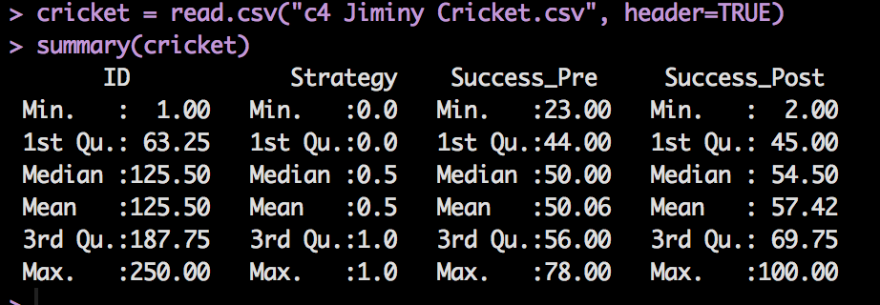
Rearranging your data
Install the reshape package and load the library!
Load the Jiminy Cricket dataset.

Slide 17
Rearranging your data
This data set is considered the WIDE format.
In wide formats, rows are participants and columns are variables.
There’s another way?
In the LONG format, rows are the multiple measurements of the participants.
Wutz?

Slide 18
Rearranging your data
Going from WIDE to LONG
melt() function
Going from LONG to WIDE
cast() function

Slide 19
Rearranging your data
MELT(
Dataframe name,
id = c(“var”, “var”) – constant variables you do not want to change
These will stay their own column but get repeated when necessary
measured = c(“var”, “var”) – dependent variables you want to combine into one column
)

Slide 20
Rearranging your data
longcricket = melt(cricket, id = c("ID", "Strategy"), measured = c("Success_Pre", "Succcess_Post"))
Let’s look at what that did.

Slide 21
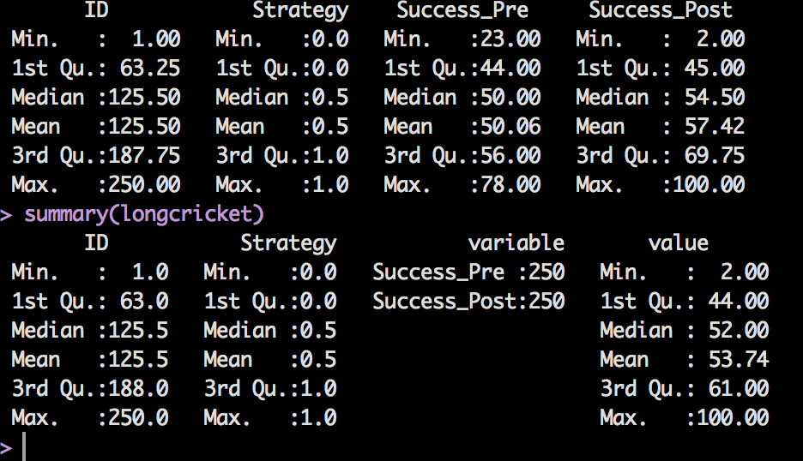
Rearranging your data

Slide 22
Rearranging your data
CAST(
Dataframe name,
Variables that are constant in math format ~ Long DV name,
value = “label” ##usually this is value
)

Slide 23
Rearranging your data
widecricket = cast(longcricket, ID + Strategy ~ variable, value = "value")
summary(widecricket)

